Slide 1
I/O and Redirection

Slide 2
Standard I/O
Standard Output (stdout)
  default place to which programs write
Standard Input (stdin)
  default place from which programs read
Standard Error (stderr)
  default place where errors are reported
To demonstrate -- cat
  Echoes everything you typed in with an <enter>
  Quits when you press Ctrl-d at a new line -- (EOF)

Slide 3
Redirecting Standard Output
cat file1 file2 > file3
  concatenates file1 and file2 into file3
  file3 is created if not there
cat file1 file2 >! file3
  file3 is clobbered if there
cat file1 file2 >> file3
  file3 is created if not there
  file3 is appended to if it is there
cat > file3
  file3 is created from whatever user provides from standard input

Slide 4
Redirecting Standard Error
Generally direct standard output and standard error to the same place:
    obelix[1] > cat myfile >& yourfile
    If myfile exists, it is copied into yourfile
    If myfile does not exist, an error message
    cat: myfile: No such file or directory
    is copied in yourfile
In tcsh, to write standard output and standard error into different files:
    obelix[2] > (cat myfile > yourfile) >& yourerrorfile
In sh (for shell scripts), standard error is redirected differently
  cat myfile > yourfile 2> yourerrorfile

Slide 5
Redirecting Standard Input
obelix[1] > cat < oldfile > newfile
A more useful example:
  obelix[2] > tr string1 string2
    Read from standard input.
    Character n of string1 translated to character n of string2.
    Results written to standard output.
  Example of use:
    obelix[3] > tr aeoiu eoiua
    obelix[4] > tr a-z A-Z < file1 > file2

Slide 6
/dev/null
/dev/null
  A virtual file that is always empty.
  Copy things to here and they disappear.
    cp myfile /dev/null
    mv myfile /dev/null
  Copy from here and get an empty file.
    cp /dev/null myfile
  Redirect error messages to this file
    (ls -l > recordfile) >& /dev/null
    Basically, all error messages are discarded.

Slide 7
Filters (1)
Filters are programs that:
  Read stdin.
  Modify it.
  Write the results to stdout.
Filters typically do not need user input.
Example:
  tr (translate):
    Read stdin
    Echo to stdout, translating some specified characters
Many filters can also take file names as operands for input, instead of using stdin.

Slide 8
Filters (2)
grep patternstr:
  Read stdin and write lines containing patternstr to stdout
  obelix[1] > grep "unix is easy" < myfile1 > myfile2
  Write all lines of myfile1 containing phrase unix is easy to myfile2
wc:
  Count the number of chars/words/lines on stdin
  Write the resulting statistics to stdout
sort:
  Sort all the input lines in alphabetical order and write to the standard output.

Slide 9
Pipes
The pipe:
  Connects stdout of one program with stdin of another
  General form:
  command1 | command2
      stdout of command1 used as stdin for command2
  Example:
    obelix[1] > cat readme.txt | grep unix | wc -l
An alternative way (not efficient) is to:
    obelix[2] > grep unix < readme.txt > tmp
    obelix[3] > wc -l < tmp
Can also pipe stderr: command1 |& command2

Slide 10
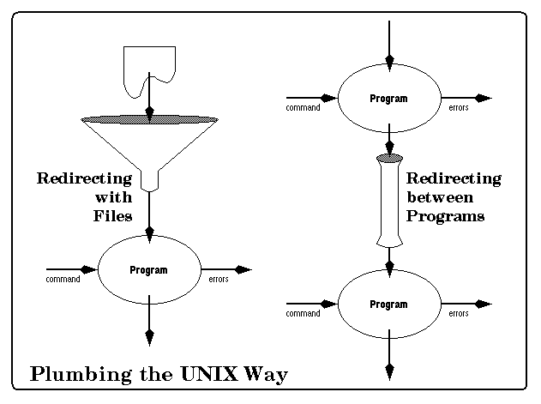
Redirecting and Pipes (1)

Slide 11
Redirecting and Pipes (2)
Note: The name of a command always comes first on the line.
There may be a tendency to say:
  obelix[1] > readme.txt > grep unix | wc -l
  This is WRONG!!!
  Your shell will go looking for a program named readme.txt
To do it correctly, many alternatives!
  obelix[1] > cat readme.txt | grep unix | wc -l
  obelix[2] > grep unix < readme.txt | wc -l
  obelix[3] > grep unix readme.txt | wc -l
  obelix[4] > grep -c unix readme.txt

Slide 12
The tee Command
tee - replicate the standard output
  cat readme.txt | tee myfile
stdin
tee
stdout
myfile

